Slide 1

Discrete Math Additional Information
Sigma and Sequences

Slide 2
Overview
Arithmetic Sequence and Geometric Sequence
Sigma and its properties

Slide 3

1. Arithmetic Sequence and Geometric Sequence

Slide 4
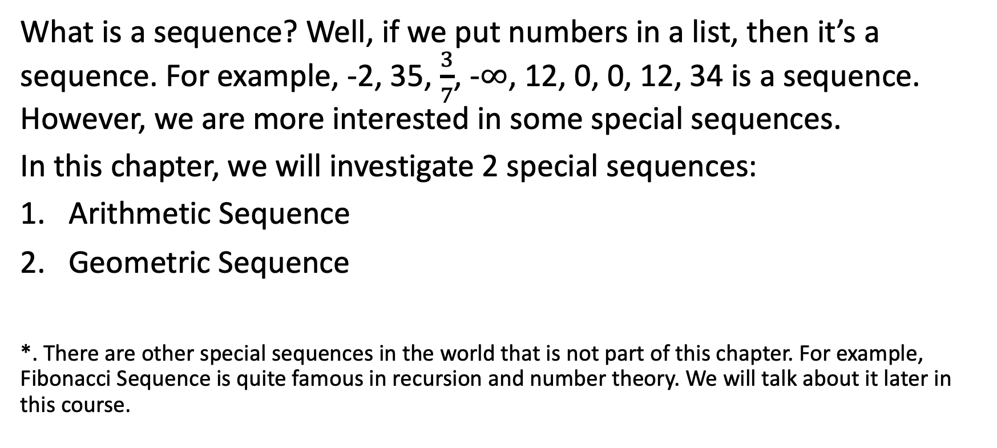
Sequence
What is a sequence? Well, if we put numbers in a list, then it’s a sequence. For example, -2, 35, $\frac{3}{7}$, -$∞$, 12, 0, 0, 12, 34 is a sequence. However, we are more interested in some special sequences.
In this chapter, we will investigate 2 special sequences:
Arithmetic Sequence
Geometric Sequence
*. There are other special sequences in the world that is not part of this chapter. For example, Fibonacci Sequence is quite famous in recursion and number theory. We will talk about it later in this course.

Slide 5
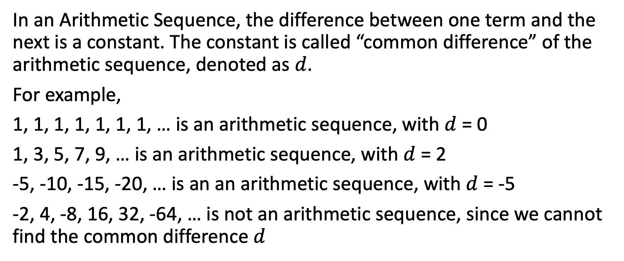
Arithmetic Sequence
In an Arithmetic Sequence, the difference between one term and the next is a constant. The constant is called “common difference” of the arithmetic sequence, denoted as $d$.
For example,
1, 1, 1, 1, 1, 1, 1, … is an arithmetic sequence, with $d$ = 0
1, 3, 5, 7, 9, … is an arithmetic sequence, with $d$ = 2
-5, -10, -15, -20, … is an an arithmetic sequence, with $d$ = -5
-2, 4, -8, 16, 32, -64, … is not an arithmetic sequence, since we cannot find the common difference $d$

Slide 6
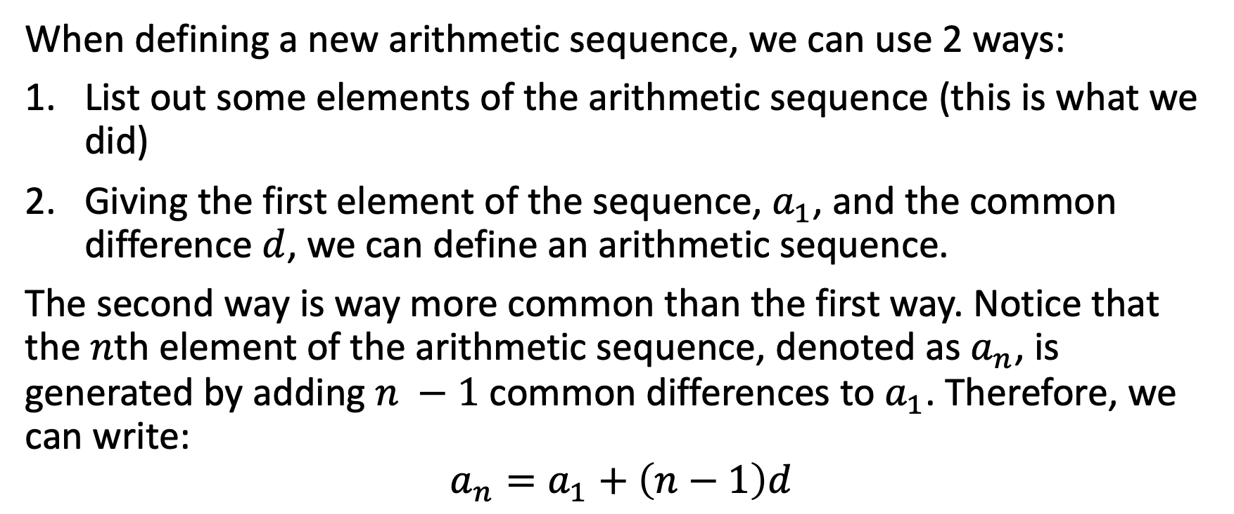
Arithmetic Sequence
When defining a new arithmetic sequence, we can use 2 ways:
List out some elements of the arithmetic sequence (this is what we did)
Giving the first element of the sequence, $a_{1}$, and the common difference $d$, we can define an arithmetic sequence.
The second way is way more common than the first way. Notice that the $n$th element of the arithmetic sequence, denoted as $a_{n}$, is generated by adding $n −1$ common differences to $a_{1}$. Therefore, we can write:
$$a_{n}=a_{1}+\left(n−1\right)d$$

Slide 7
Sum of Arithmetic Sequence
Given an Arithmetic Sequence, how can we find the sum of all elements in this sequence? For example, what’s the sum of all elements in arithmetic sequence 1, 2, 3, 4, …, 100?
Do this manually. We add all numbers together. Computer programs can do this in a reasonable time period. We can use either a for loop or recursion to do this.
It would be nice if we can find some kind of formula, so that it would be easier for human to find the sum. Also, computer programs that implement the formula can finish running faster.

Slide 8
Pseudocode of 2 solutions
function add(n):
sum = 0
for i from 1 to n:
sum = sum + i
return sum
function add(n):
if n is zero:
return 0
else:
return n + add(n - 1)

Slide 9
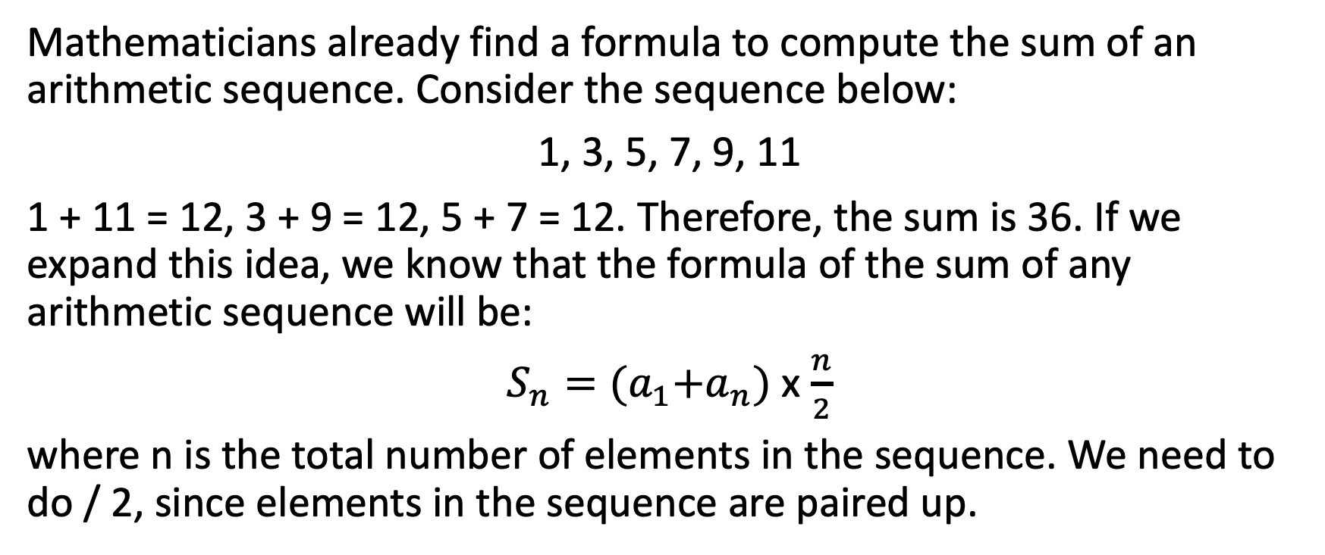
Sum of Arithmetic Sequence
Mathematicians already find a formula to compute the sum of an arithmetic sequence. Consider the sequence below:
1, 3, 5, 7, 9, 11
1 + 11 = 12, 3 + 9 = 12, 5 + 7 = 12. Therefore, the sum is 36. If we expand this idea, we know that the formula of the sum of any arithmetic sequence will be:
$S_{n}={(a}_{1}+a_{n})$ x $\frac{n}{2}$
where n is the total number of elements in the sequence. We need to do / 2, since elements in the sequence are paired up.

Slide 10
Example 1
Find the result of 7 + 5 + 3 + … + (-15)

Slide 11
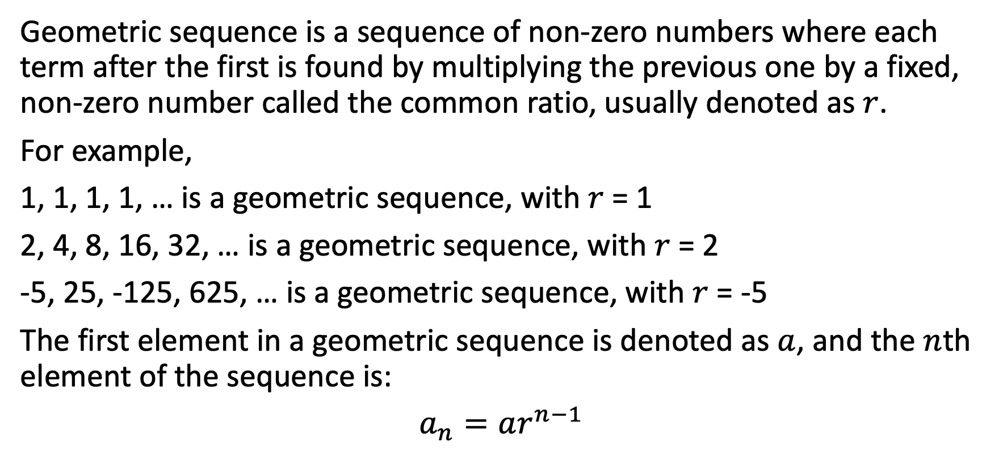
Geometric Sequence
Geometric sequence is a sequence of non-zero numbers where each term after the first is found by multiplying the previous one by a fixed, non-zero number called the common ratio, usually denoted as $r$.
For example,
1, 1, 1, 1, … is a geometric sequence, with $r$ = 1
2, 4, 8, 16, 32, … is a geometric sequence, with $r$ = 2
-5, 25, -125, 625, … is a geometric sequence, with $r$ = -5
The first element in a geometric sequence is denoted as $a$, and the $n$th element of the sequence is:
$a_{n}=ar^{n−1}$

Slide 12
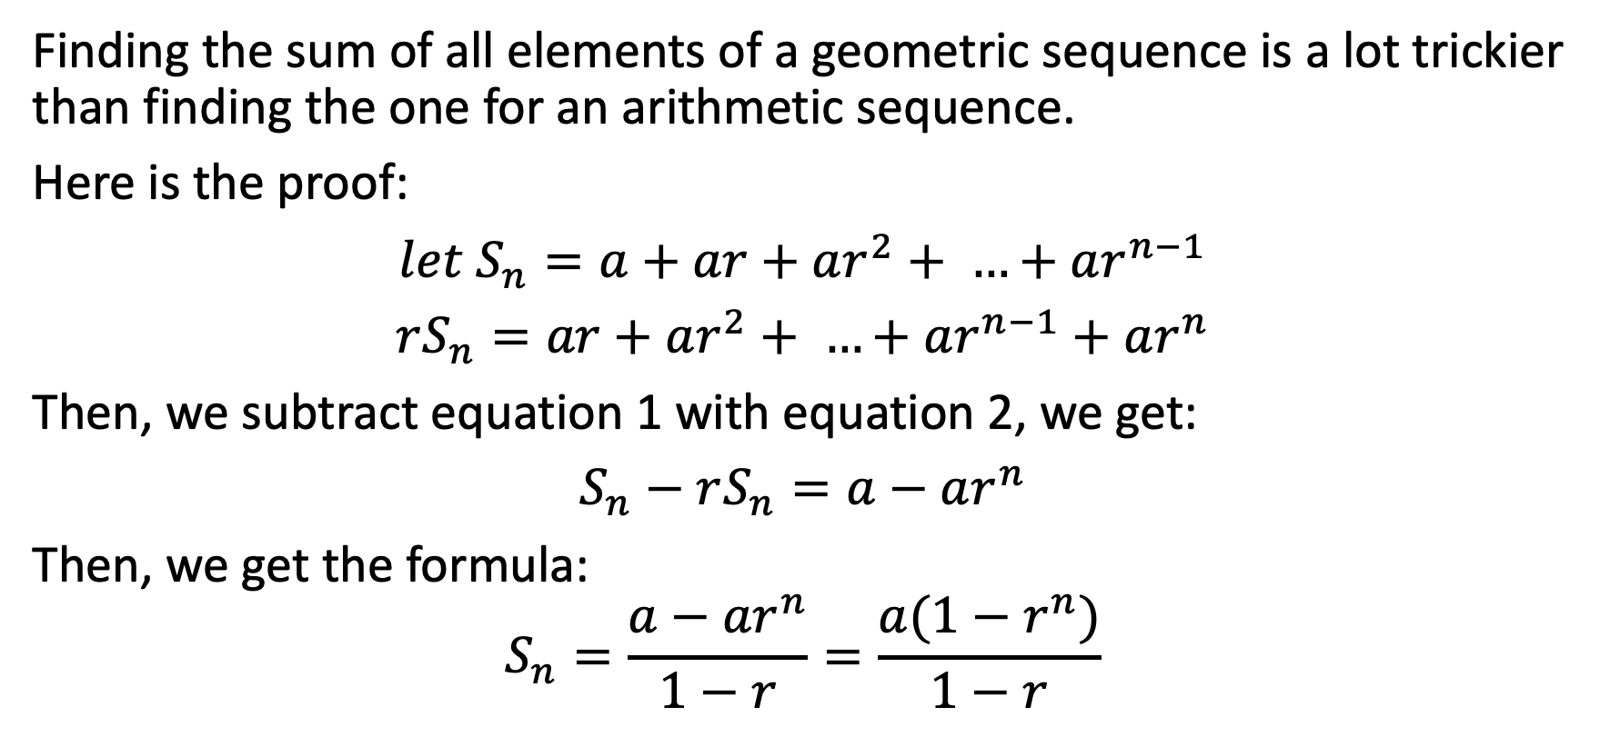
Sum of Geometric Sequence
Finding the sum of all elements of a geometric sequence is a lot trickier than finding the one for an arithmetic sequence.
Here is the proof:
$let S_{n}=a+ar+ar^{2}+ …+ar^{n−1}$
$rS_{n}=ar+ar^{2}+ …+ar^{n−1}\text{ + }ar^{n}$
Then, we subtract equation 1 with equation 2, we get:
$S_{n}−rS_{n}=a−ar^{n}$
Then, we get the formula:
$$S_{n}=\frac{a−ar^{n}}{1−r}=\frac{a(1−r^{n})}{1−r}$$

Slide 13
Example 2
Find the result of 1 + 3 + 9 + 27 + 81 + 243 by using the formula.

Slide 14

2. Sigma and its properties

Slide 15
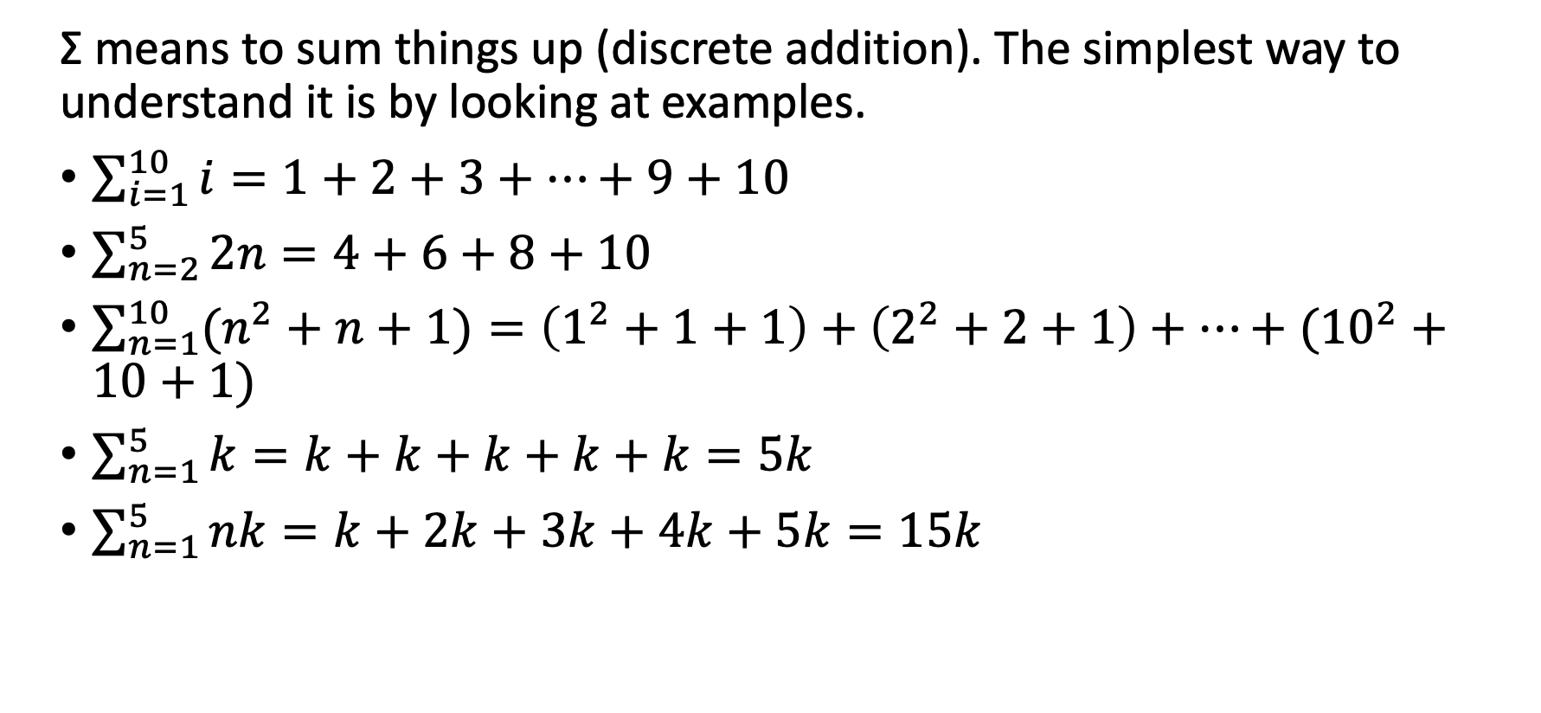
Sigma Notation Σ
Σ means to sum things up (discrete addition). The simplest way to understand it is by looking at examples.
$\sum_{i=1}^{10}{i}=1+2+3+…+9+10$
$\sum_{n=2}^{5}{2n}=4+6+8+10$
$\sum_{n=1}^{10}{(n^{2}+n+1)}=\left(1^{2}+1+1\right)+\left(2^{2}+2+1\right)+…+({10}^{2}+10+1)$
$\sum_{n=1}^{5}{k}=k+k+k+k+k=5k$
$\sum_{n=1}^{5}{nk}=k+2k+3k+4k+5k=15k$

Slide 16
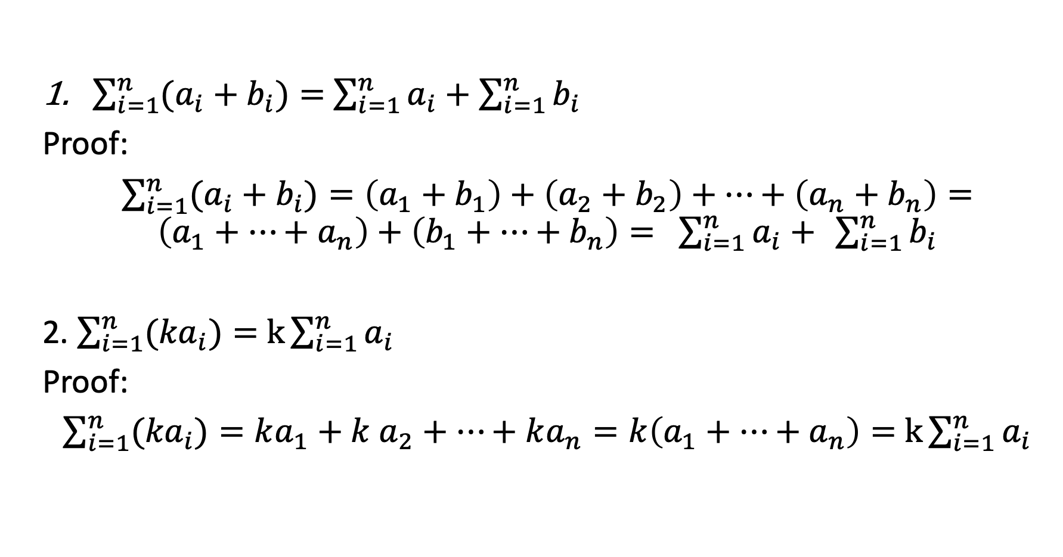
Properties of Sigma Σ
$\sum_{i=1}^{n}{(a_{i}+b_{i})}=$ $\sum_{i=1}^{n}{a_{i}+}$ $\sum_{i=1}^{n}{b_{i}}$
Proof:
$\sum_{i=1}^{n}{(a_{i}+b_{i})}=\left(a_{1}+b_{1}\right)+\left(a_{2}+b_{2}\right)+…+\left(a_{n}+b_{n}\right)=\left(a_{1}+…+a_{n}\right)+\left(b_{1}+…+b_{n}\right)= \sum_{i=1}^{n}{a_{i}+} \sum_{i=1}^{n}{b_{i}}$
2. $\sum_{i=1}^{n}{({ka}_{i})}=$ $k\sum_{i=1}^{n}{a_{i}}$
Proof:
$\sum_{i=1}^{n}{({ka}_{i})}=ka_{1}+k$ $a_{2}+…+ka_{n}=k\left(a_{1}+…+a_{n}\right)=$ $k\sum_{i=1}^{n}{a_{i}}$

Slide 17
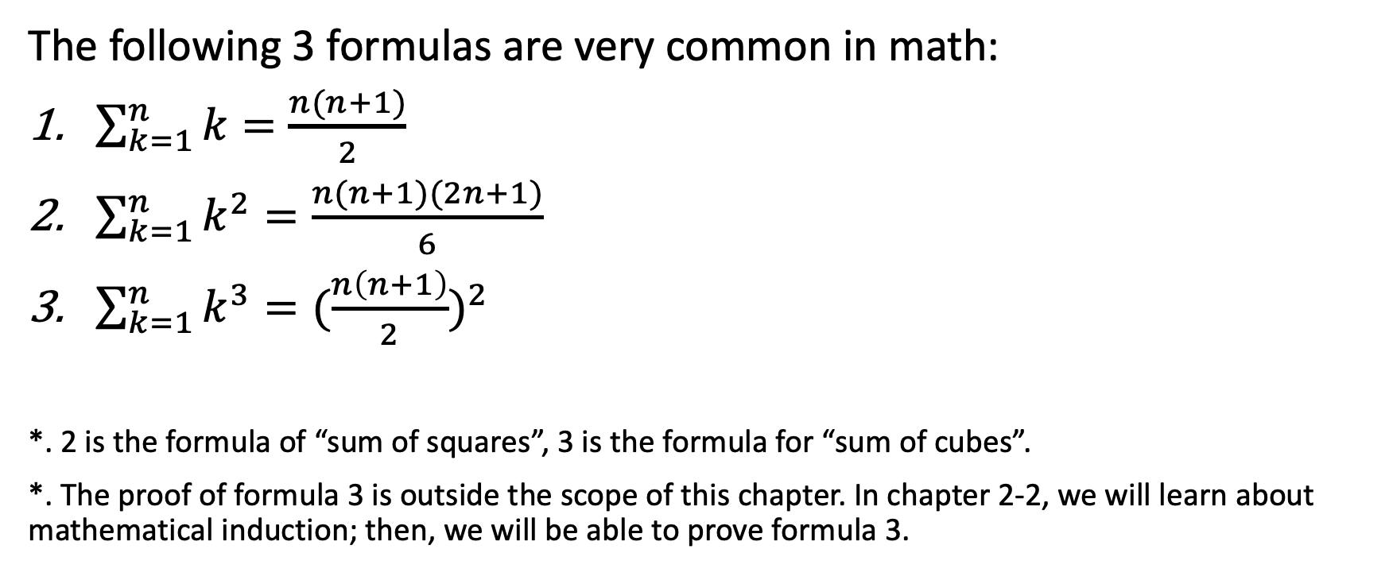
Common Formula in Sigma
The following 3 formulas are very common in math:
$\sum_{k=1}^{n}{k}=\frac{n(n+1)}{2}$
$\sum_{k=1}^{n}{k^{2}}=\frac{n(n+1)(2n+1)}{6}$
$\sum_{k=1}^{n}{k^{3}}={(\frac{n\left(n+1\right)}{2})}^{2}$
*. 2 is the formula of “sum of squares”, 3 is the formula for “sum of cubes”.
*. The proof of formula 3 is outside the scope of this chapter. In chapter 2-2, we will learn about mathematical induction; then, we will be able to prove formula 3.

Slide 18
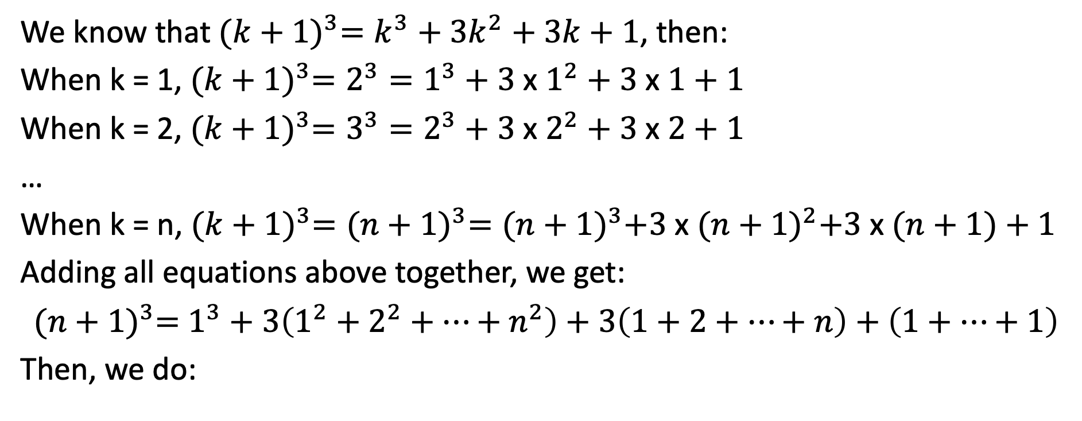
Proof of Sum of Squares
We know that ${(k+1)}^{3}=k^{3}+3k^{2}+3k+1$, then:
When k = 1, ${(k+1)}^{3}=2^{3}=1^{3}+3$ x $1^{2}+3$ x $1+1$
When k = 2, ${(k+1)}^{3}=3^{3}=2^{3}+3$ x $2^{2}+3$ x $2+1$
…
When k = n, ${(k+1)}^{3}={(n+1)}^{3}={(n+1)}^{3}+3$ x ${(n+1)}^{2}+3$ x $(n+1)+1$
Adding all equations above together, we get:
${(n+1)}^{3}=$ $1^{3}+3\left(1^{2}+2^{2}+…+n^{2}\right)+3\left(1+2+…+n\right)+\left(1+…+1\right)$
Then, we do:

Slide 19
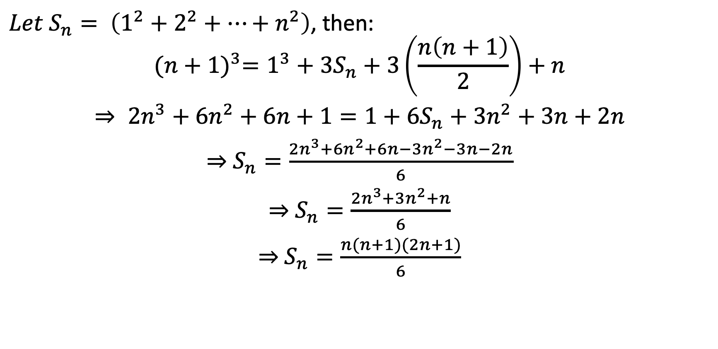
Proof of Sum of Squares
$Let S_{n}= \left(1^{2}+2^{2}+…+n^{2}\right)$, then:
$${(n+1)}^{3}=1^{3}+3S_{n}+3\left(\frac{n\left(n+1\right)}{2}\right)+n$$
$⇒ {2n}^{3}+6n^{2}+6n+1=1+6S_{n}+3n^{2}+3n+2n$
$⇒$ $S_{n}=\frac{2n^{3}+6n^{2}+6n−3n^{2}−3n−2n}{6}$
$⇒$ $S_{n}=\frac{2n^{3}+3n^{2}+n}{6}$
$⇒$ $S_{n}=\frac{n(n+1)(2n+1)}{6}$

Slide 20

Example 3
Compute the value of $1^{2}+2^{2}+…+{10}^{2}$ by using the formula.

Slide 21

Example 4
Compute the value of ${10}^{2}+{11}^{2}+…+{20}^{2}.$

Slide 22
Example 5
Find the value of 1x3 + 3x5 + 5x7 + …. + 29x31

Slide 23
Example 6
Find the value of 5 x 8 + 6 x 9 + … + n x (n + 3) in terms of n.

